Slide 1
FIRST FIT, BEST FIT, WORST FIT MEMORY ALLOCATION
CSE323: OPERATING SYSTEM
GROUP MEMBERS:
Mojahidul Islam Rakib (2111077642)
Md. Maruf Rahman (2111978642)
Sumiya Sultana (2021395642)
Sheikh Tanvir Hossain (2111647642)

Slide 2
Table of contents_
01
03
02
04
Introduction
User Requirement
Design
Implementation & Conclusion

Slide 3
01
Introduction_

Slide 4
Introduction_
Introduction
Objective
Memory allocation is a critical aspect of operating systems and memory management. Efficient memory allocation strategies are essential to optimize system performance and resource utilization. Various memory allocation algorithms have been developed to fulfill this task. This project compares and contrasts three popular memory allocation algorithms: First Fit, Best Fit, and Worst Fit. These algorithms are used to allocate memory blocks to processes, and each has its own advantages and disadvantages
To provide a comprehensive overview of three memory allocation algorithms: Fast Fit, Best Fit, and Worst Fit. Memory allocation is a critical aspect of computer systems, and choosing the right algorithm can significantly impact system performance

Slide 5
User Requirement
Efficient memory utilization
Minimized fragmentation
Adaptability

Slide 6
Design
UML Diagram
Flowchart
Sequence Diagram
Class Diagram
State Diagram

Slide 7
UML Diagram
Memory Allocation
No. of Process: int process; No. of Block : int blocks; Process Size : int p[] = new int[process]; Block Size : int b[] = new int[blocks]; First_fit_allocation(p, b, process, blocks); Best_fit_allocation(p, b, process, blocks); Worst_fit_allocation(p, b, process, blocks);

Slide 8
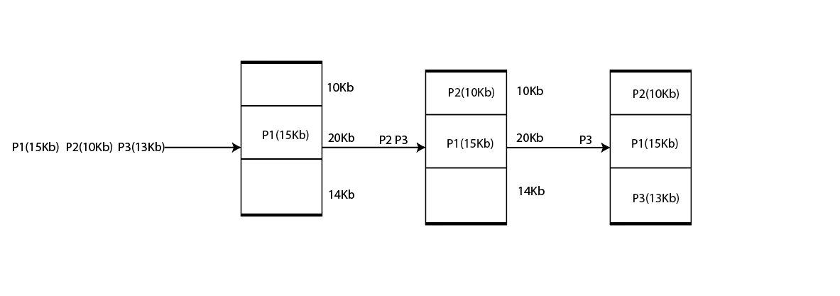
Sequence Diagram

Slide 9
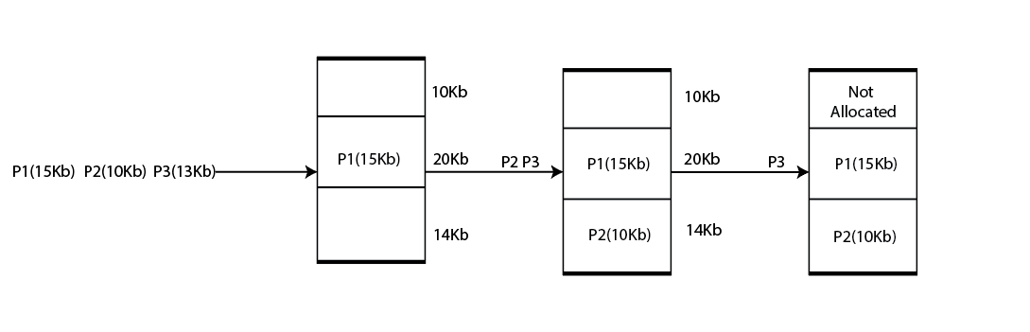
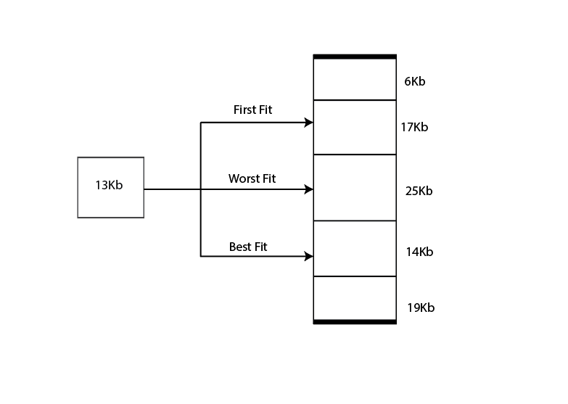

Slide 10
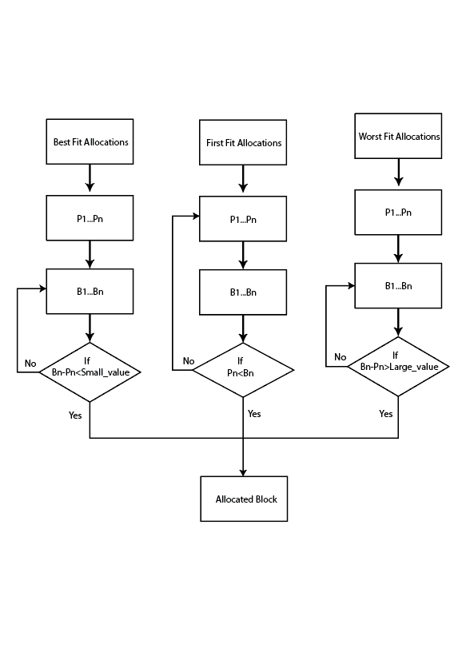
FLOW CHART

Slide 11
Class Diagram
Parent Class
No. of Process: int process; No. of Block : int blocks; Process Size : int p[] = new int[process]; Block Size : int b[] = new int[blocks];
First_fit_allocation (p, b, process, blocks);
Best_fit_allocation (p, b, process, blocks);
Worst_fit_allocation (p, b, process, blocks);

Slide 12
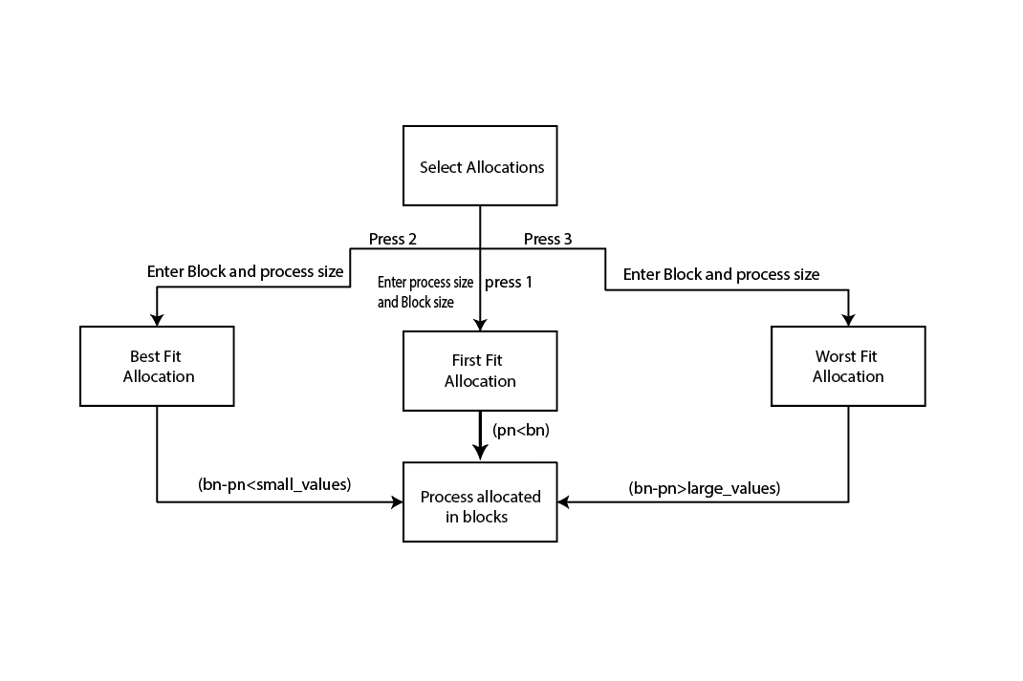
State Diagram

Slide 13
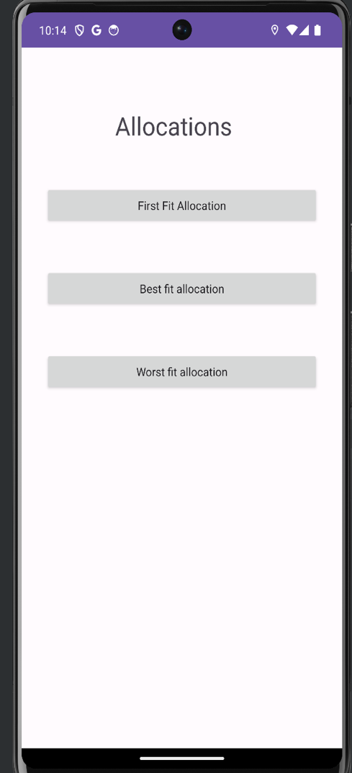
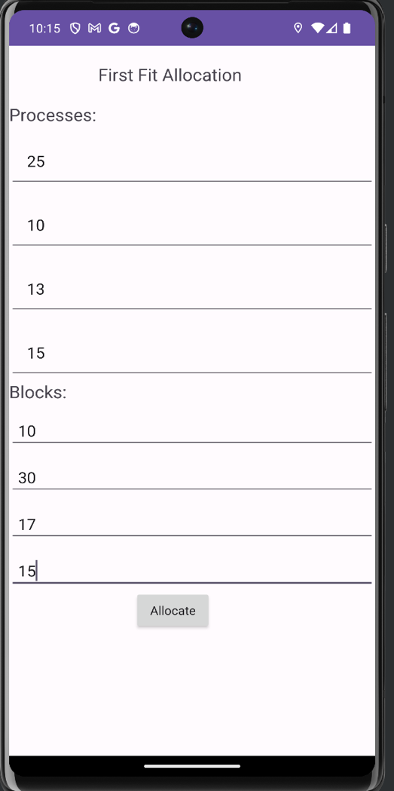
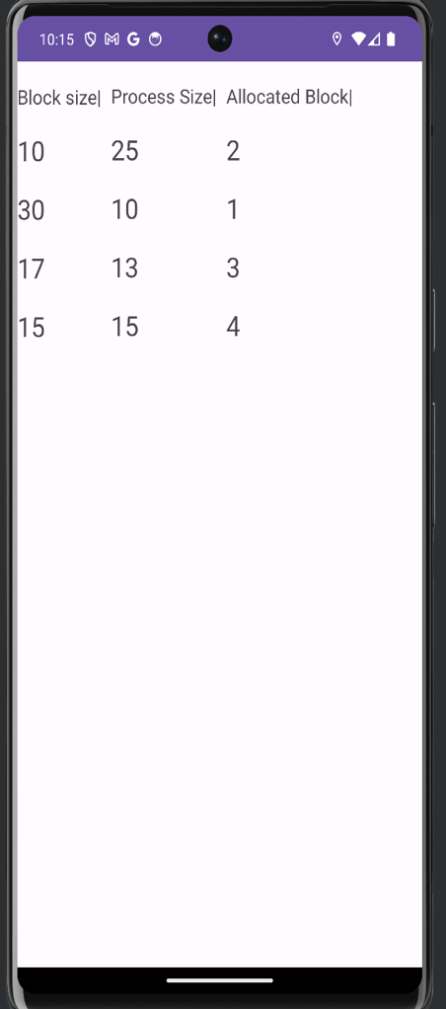
Implementation

Slide 14
Conclusion

Slide 15
Q&A
Thank YOU

